Slide 1


micro:bit programming tutorial
Lesson 5
micro:bit basic lesson 5“Keyboard”
Yahboom micro:bit tutorial

Slide 2
micro:bit programming tutorial
Part1
Part 2
Part3
Part 4
Part 5
Learning goals
Preparation
Search for blocks
Combine blocks
Have a try
Yahboom micro:bit tutorial

Slide 3
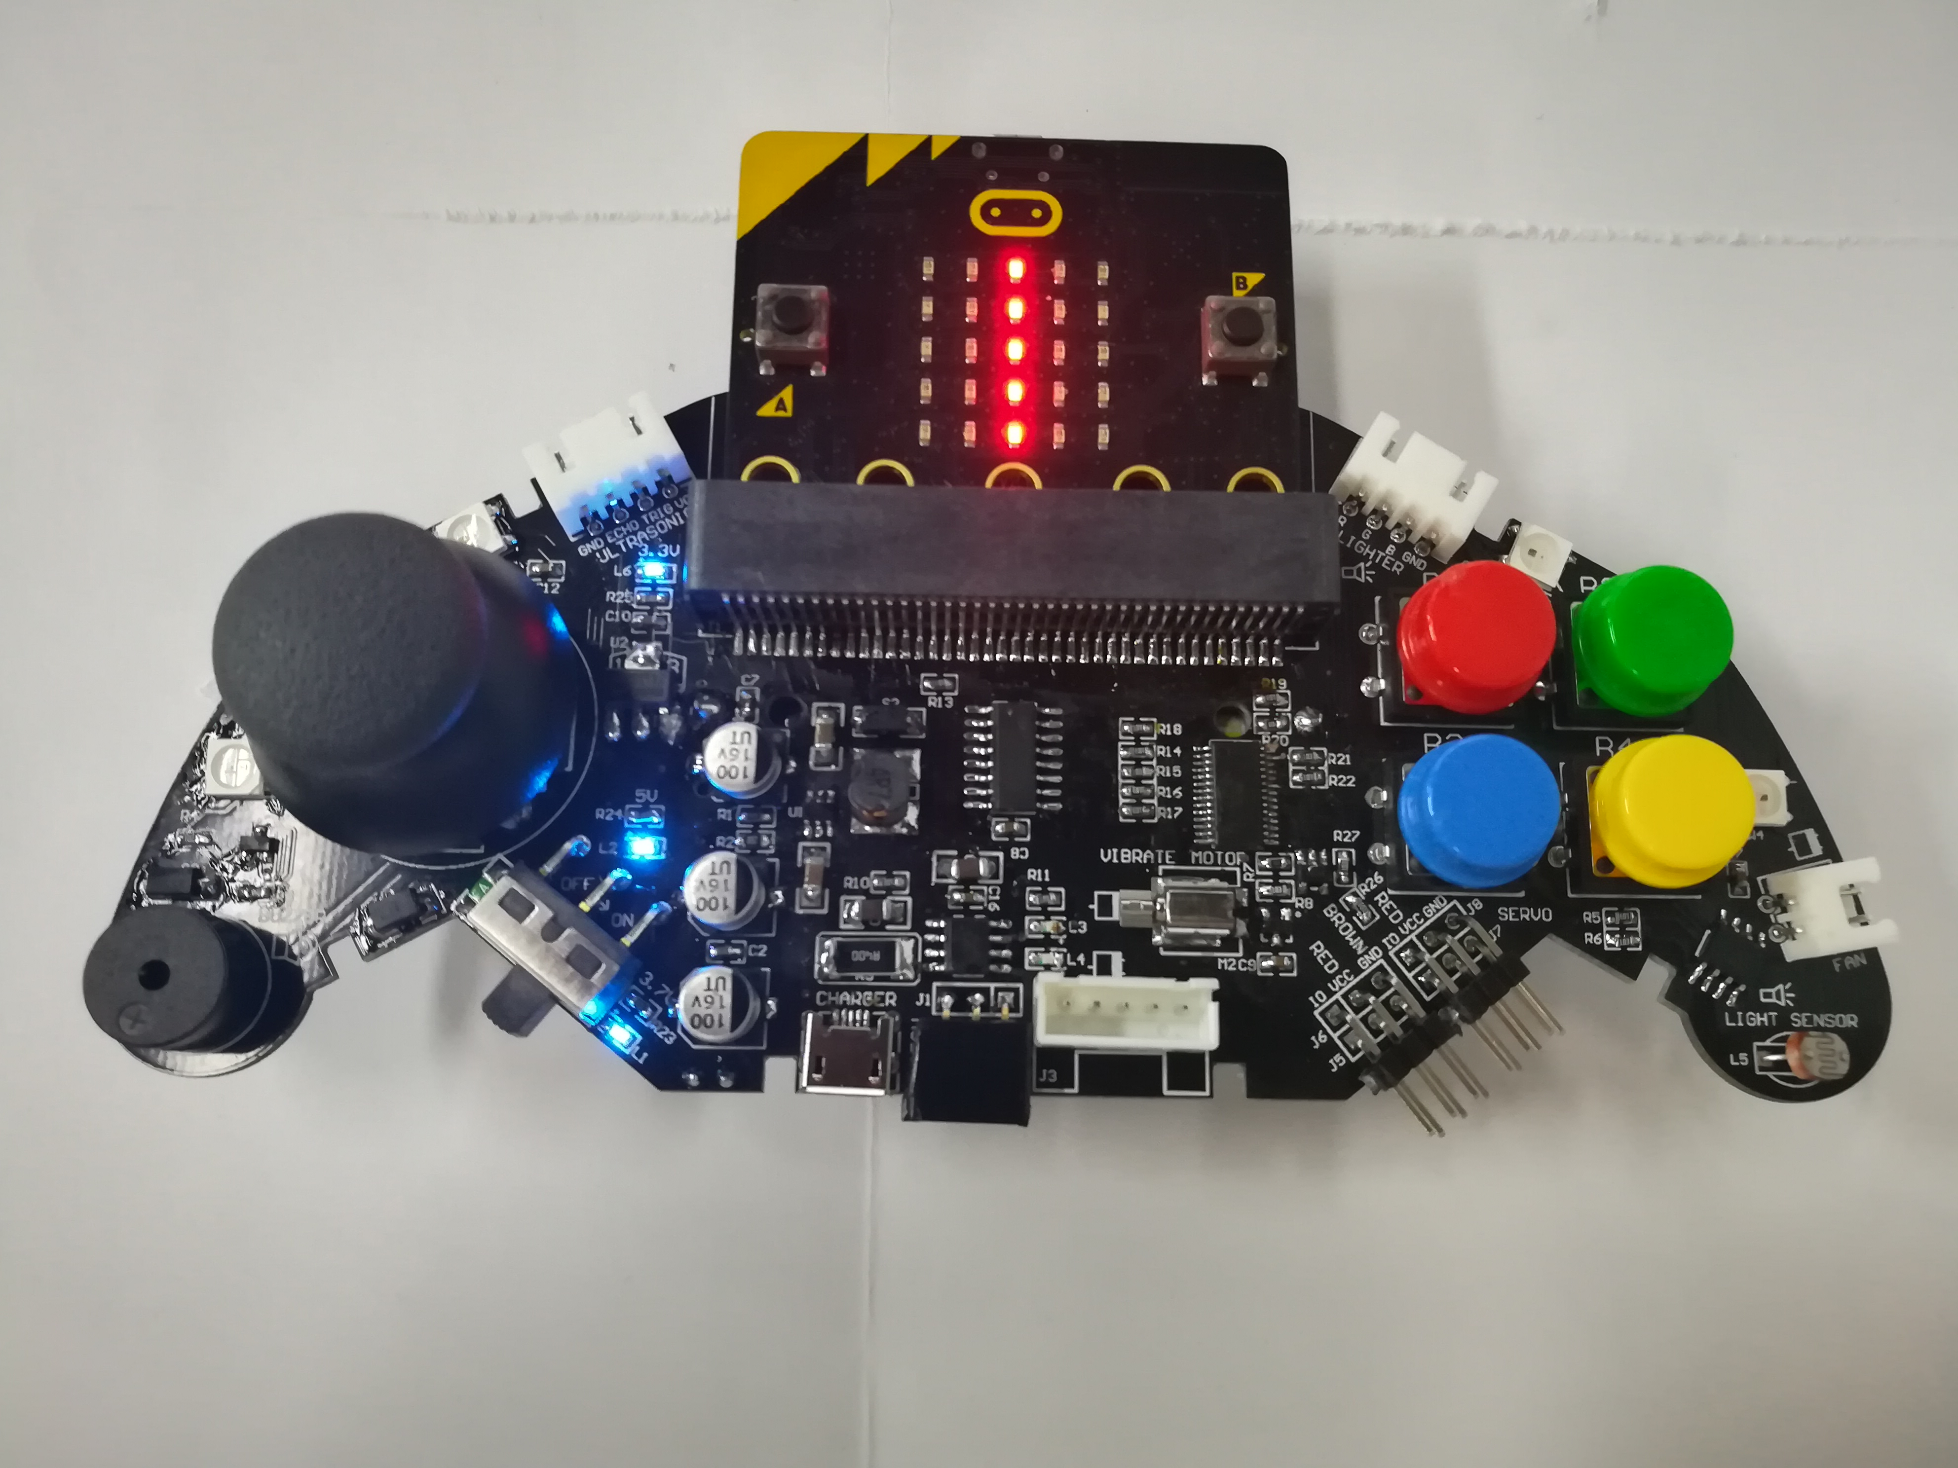
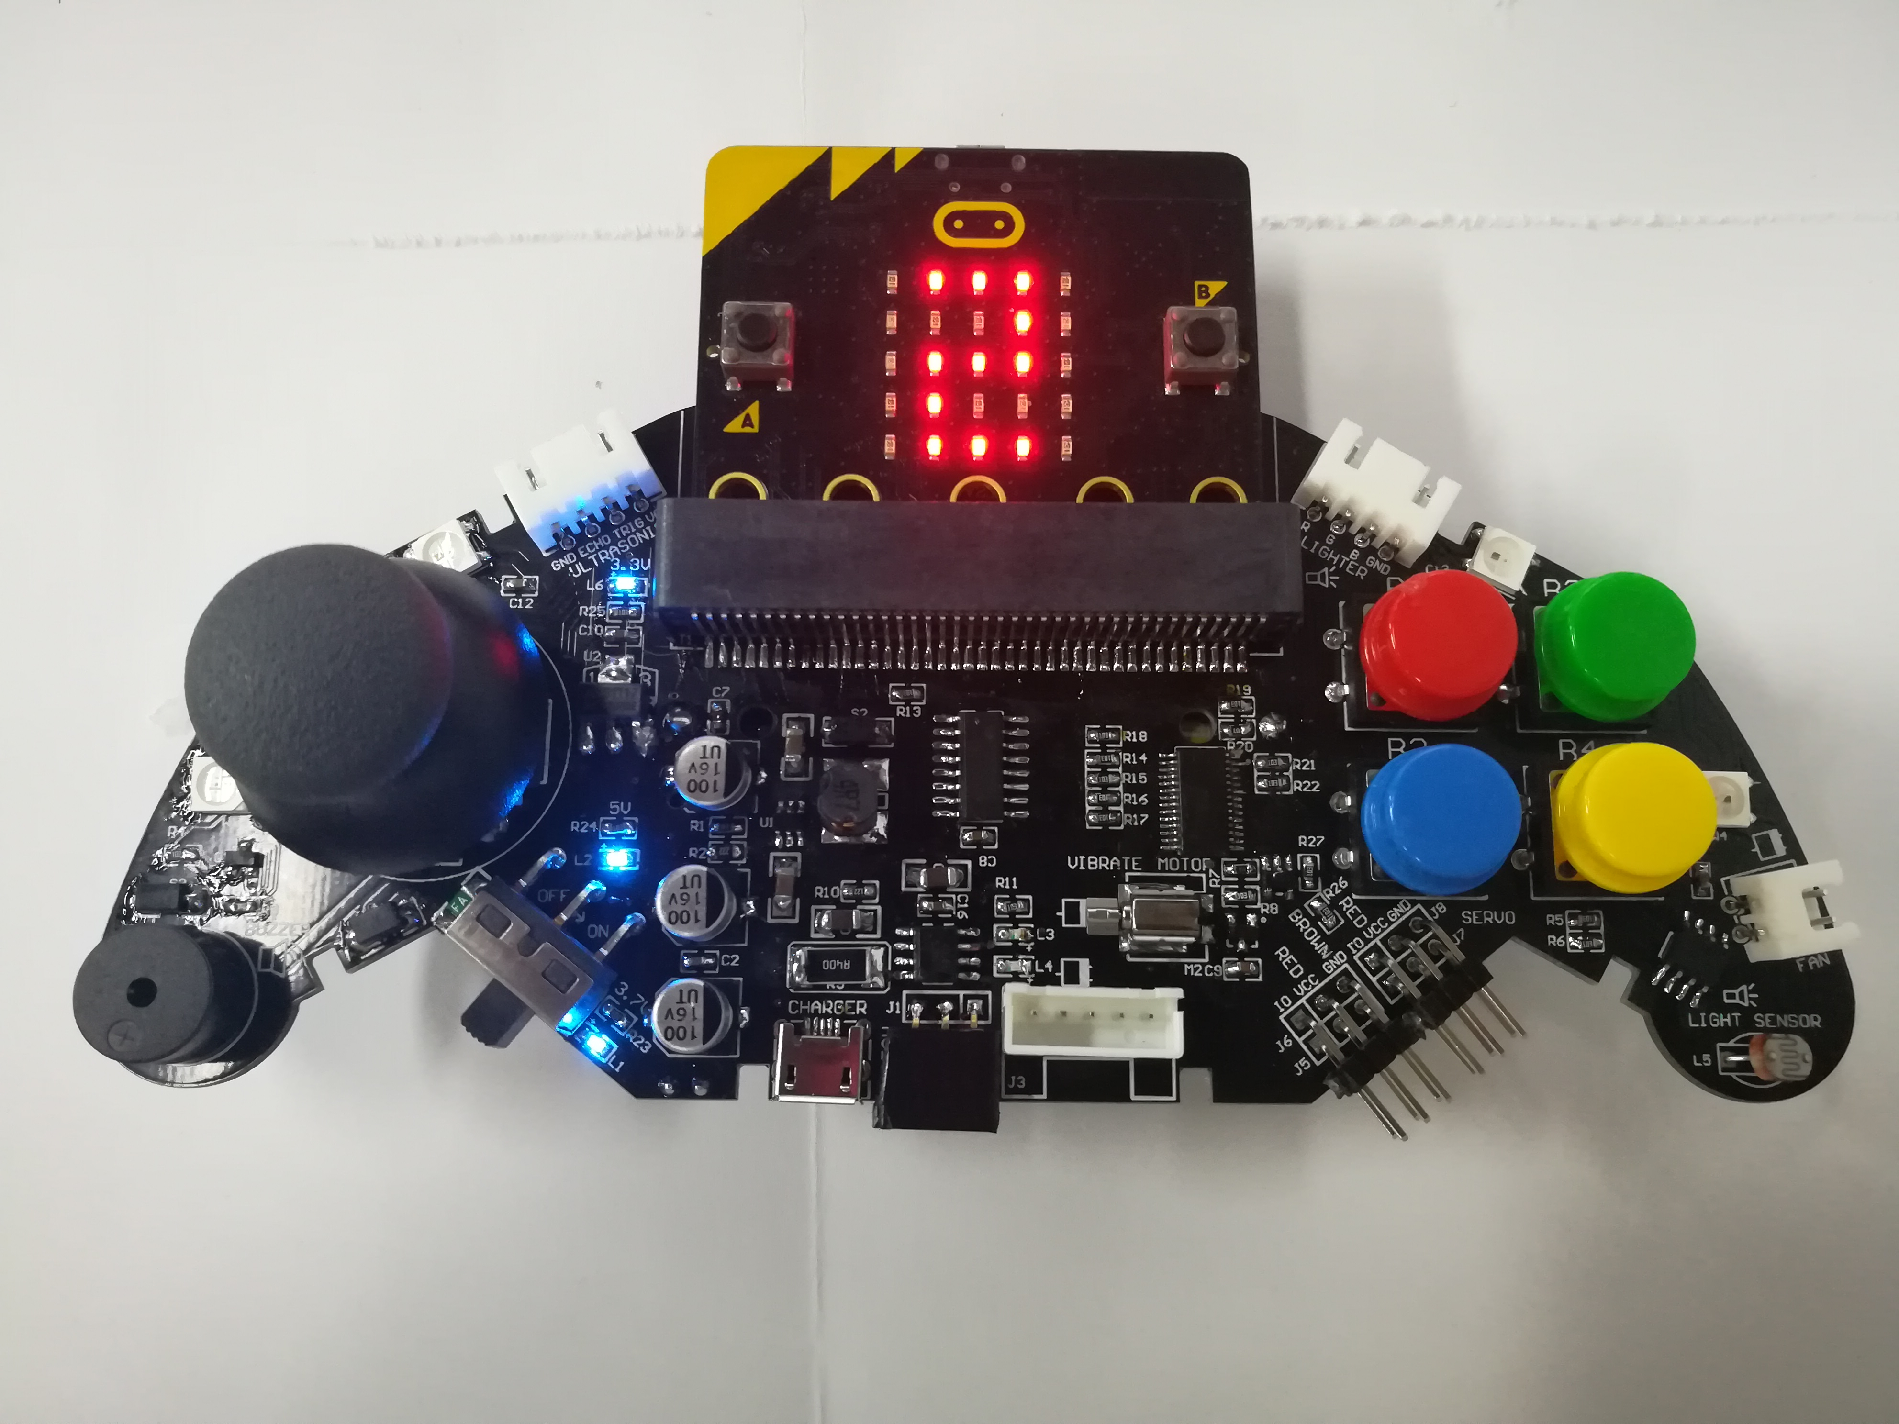
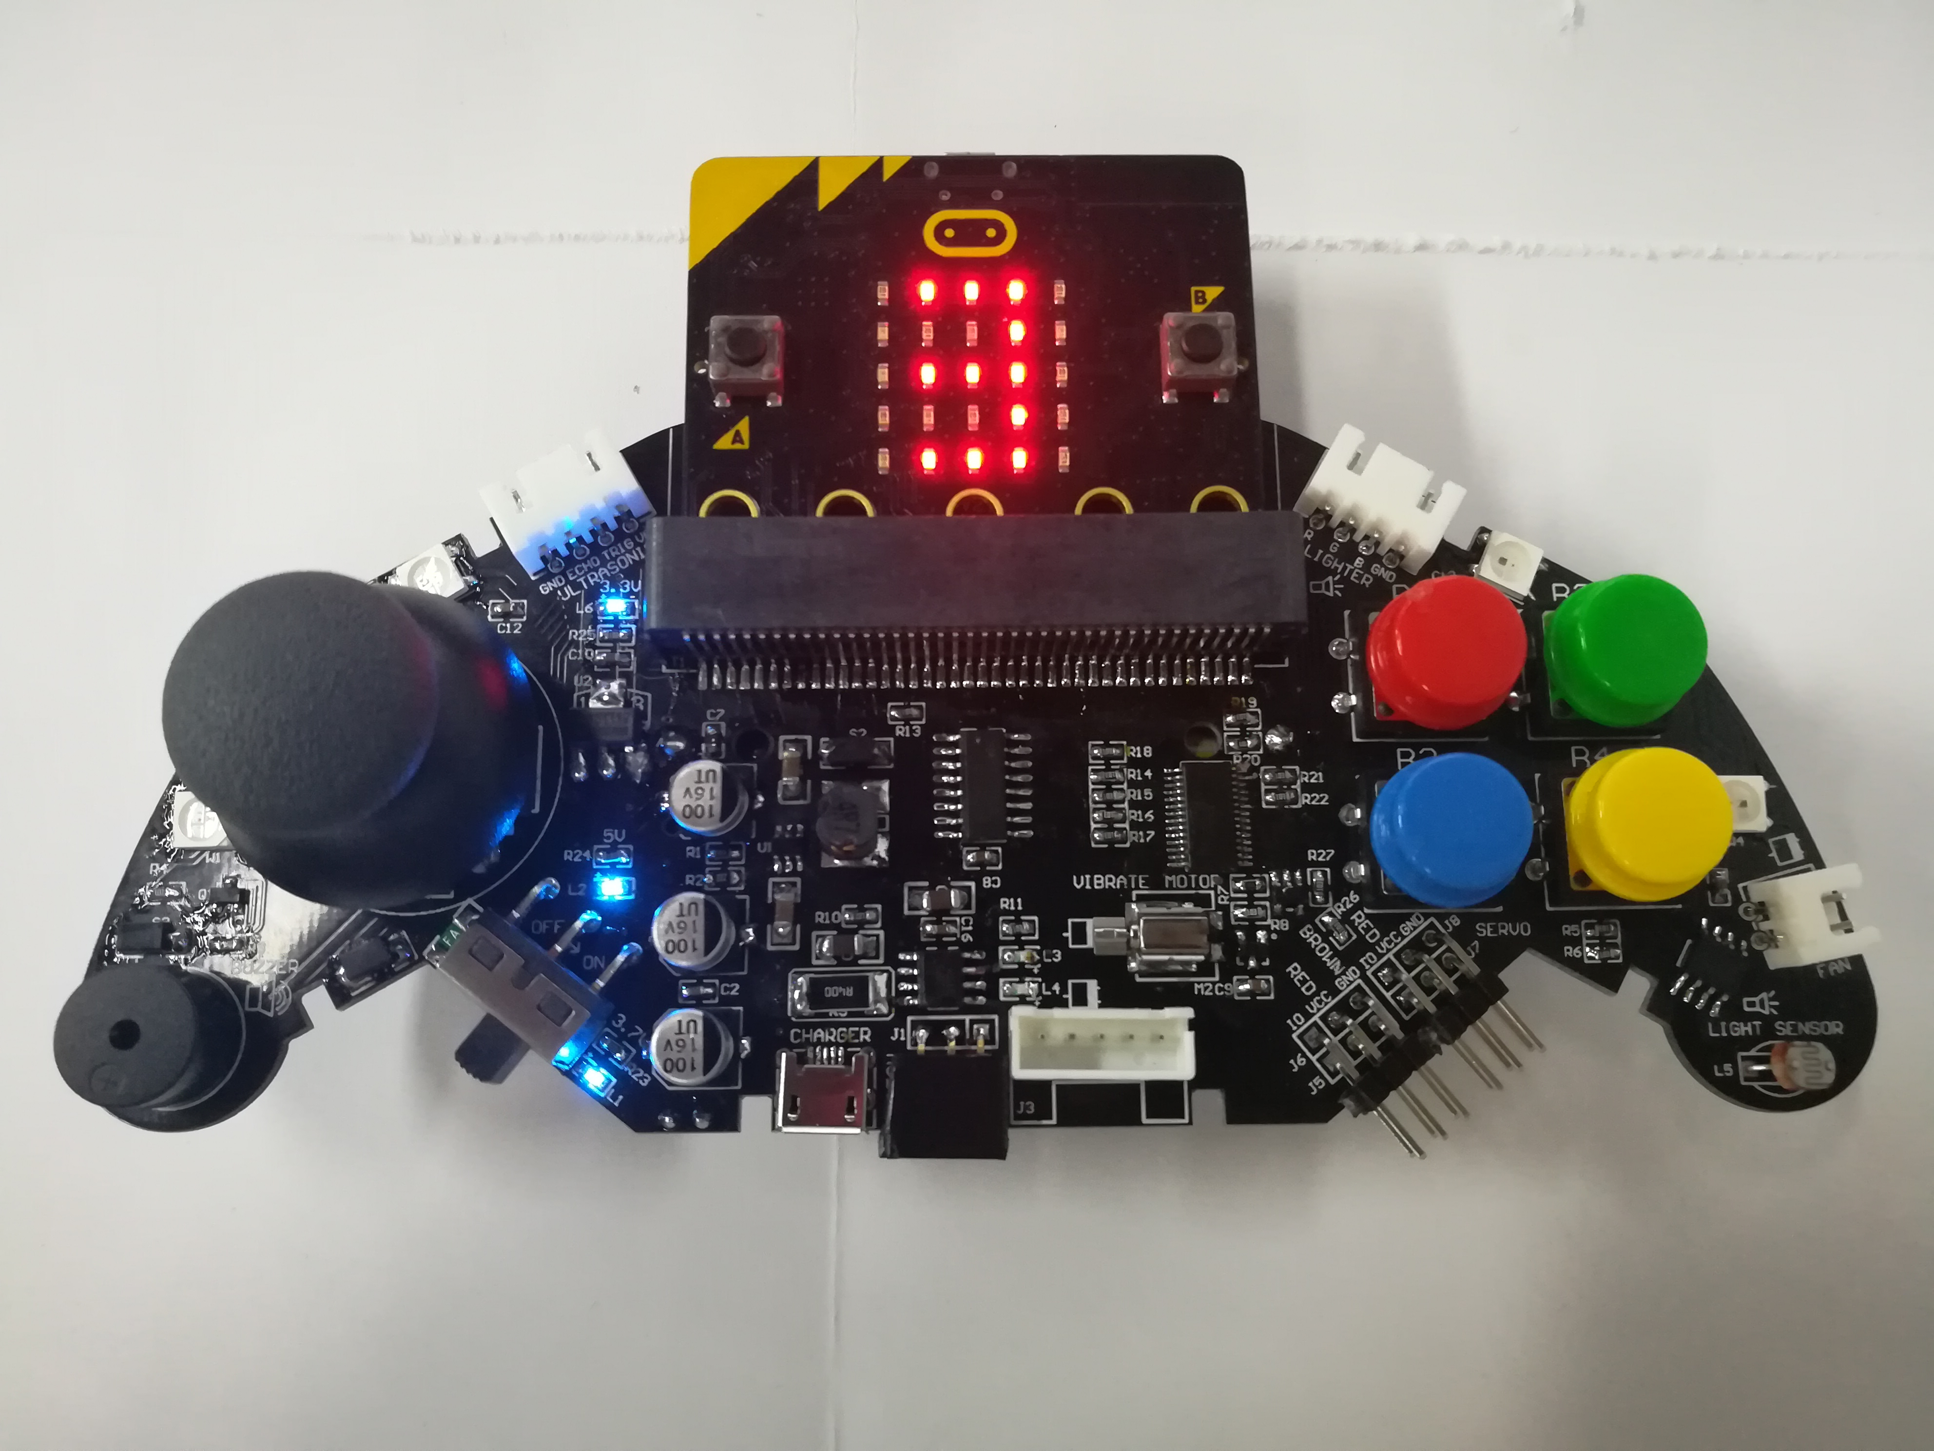
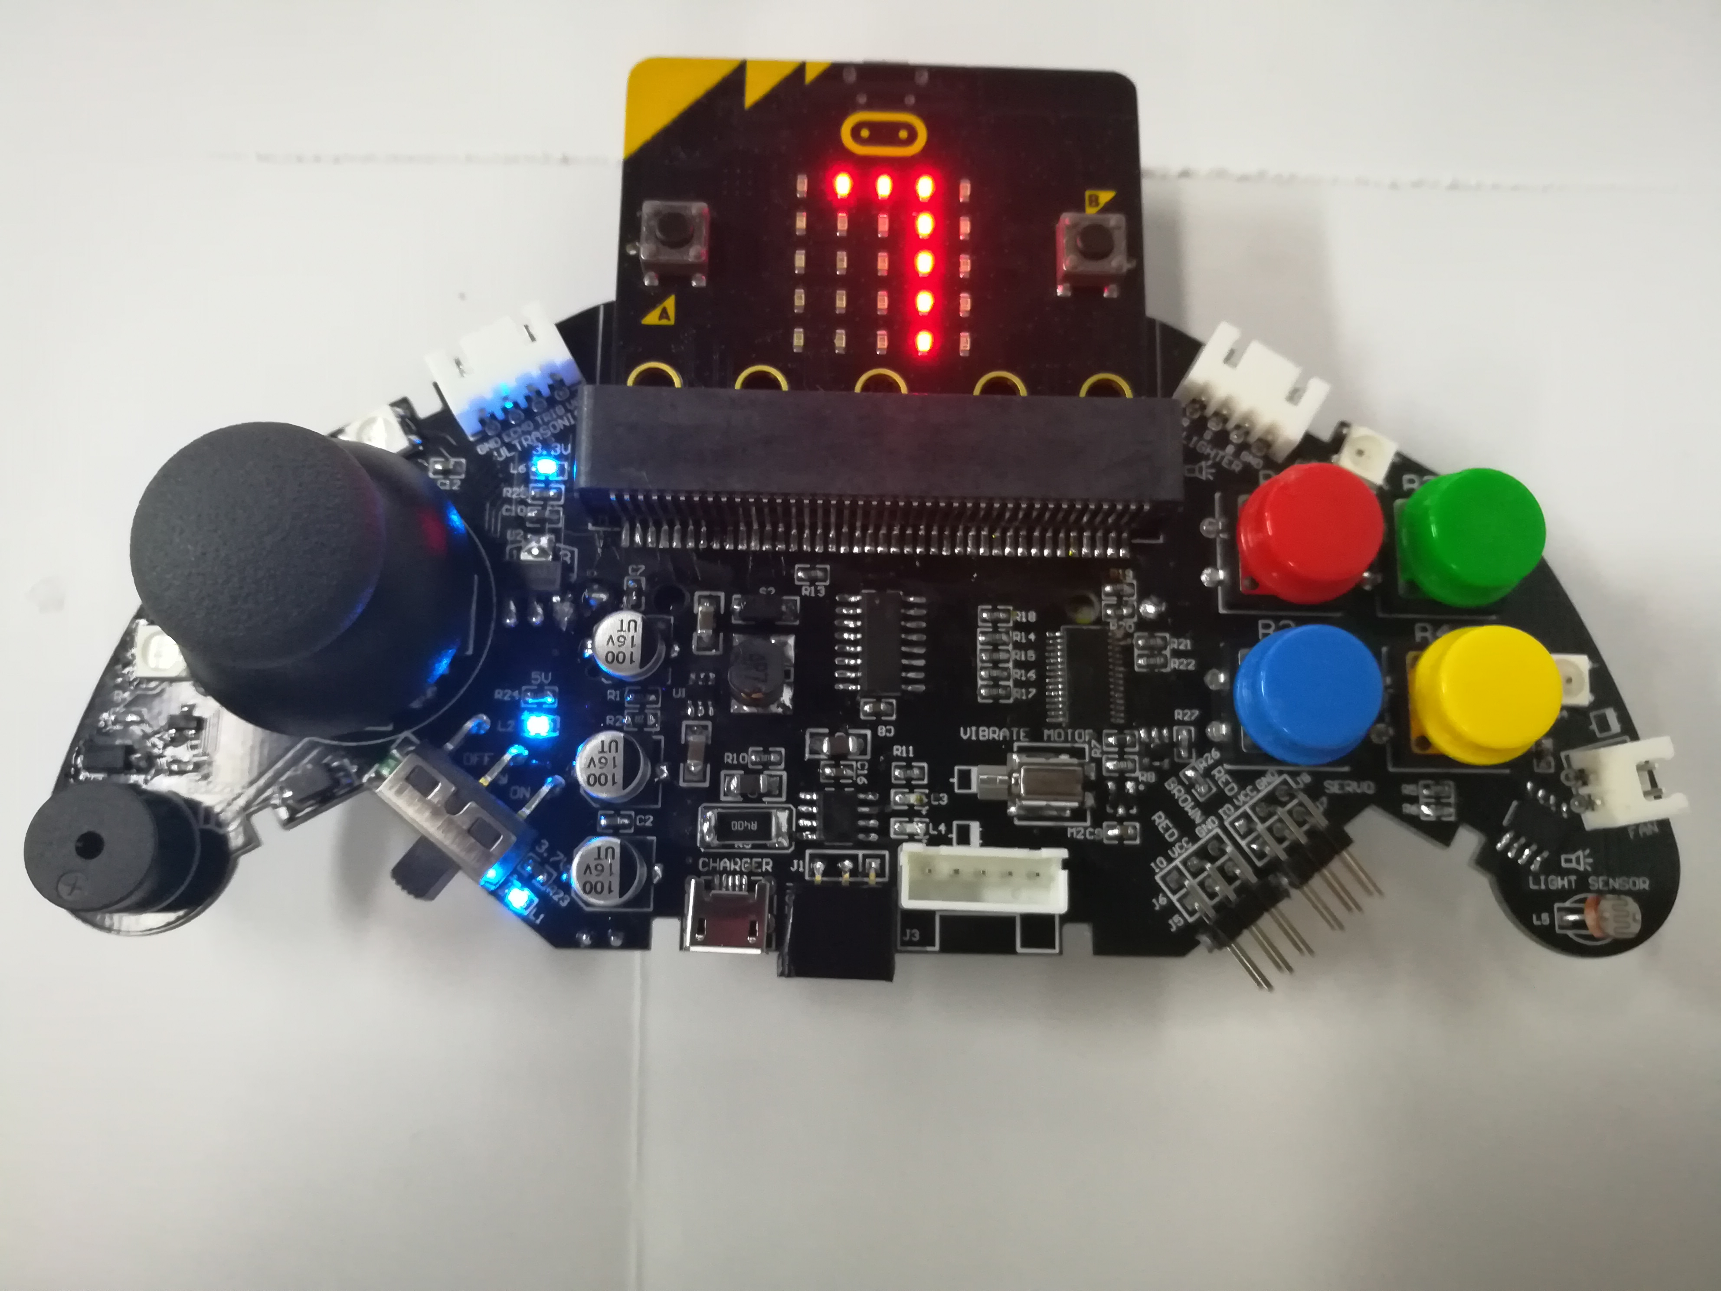
micro:bit programming tutorial
Part1
When the program is downloaded, move the rocker on the left side of the handle, or press the button on the right side of the rocker. The buzzer will emit different scales and the corresponding notes will be displayed on the screen. Let's try the fun keyboard!
Yahboom micro:bit tutorial

Slide 4
micro:bit programming tutorial
Part2
Hardware：
● 1 X micro:bit Game Handle
● 1 X Micro USB Cable
Yahboom micro:bit tutorial

Slide 5
micro:bit programming tutorial
Two programming methods
Part2
1.Online: Connect Micro:bit to the computer via USB cable, and the computer will pop up a U disk and click the URL in the U disk to enter the programming interface.Enter this URL https://github.com/lzty634158/GHBit to get the package named GHBit.
2.offline：Open micro:bit offline programming software and add GHBit package.Click on "Advanced" and select "Add Package".Enter this URL https://github.com/lzty634158/GHBit to get the package named GHBit.
Note: If you already have a GHBit package, you don't need to add it repeatedly.
Yahboom micro:bit tutorial

Slide 6
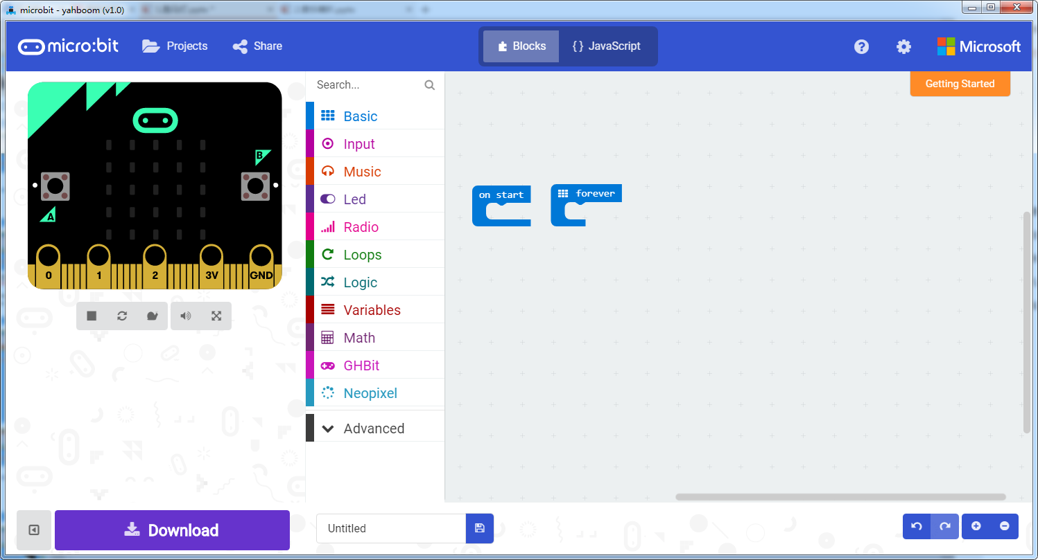
micro:bit programming tutorial
Programming interface
Part3
Yahboom micro:bit tutorial

Slide 7
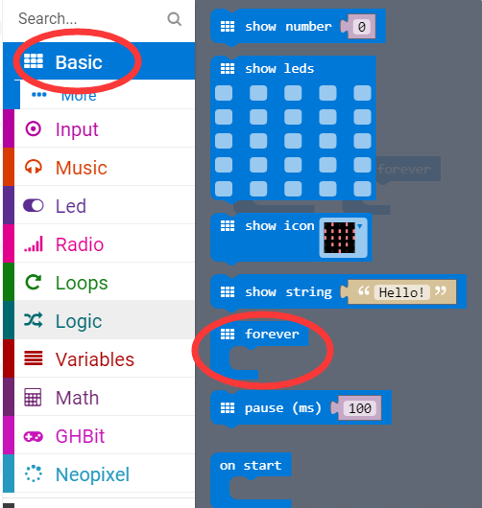
micro:bit programming tutorial
Part3
Start programming
The “forever” building block means that when the micro:bi Game Handle is turned on, the blocks in “forever” are repeatedly executed.
Yahboom micro:bit tutorial

Slide 8
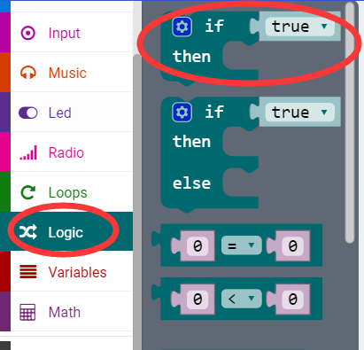
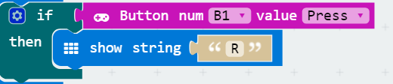
micro:bit programming tutorial
Part3
If a value is true, then do some statements.
For example: If the B1 button of the handle is pressed, the dot matrix display character R is executed. If the B1 button is not pressed, it will not be executed.
Yahboom micro:bit tutorial

Slide 9
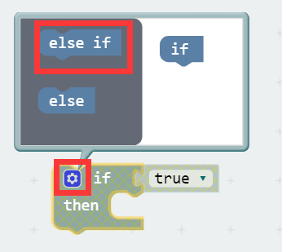
micro:bit programming tutorial
Part3
When there are many choices, you can click on the pinion above. Drag the "else if" on the left to the bottom of the "if" on the right, and click on the pinion again.
Yahboom micro:bit tutorial

Slide 10
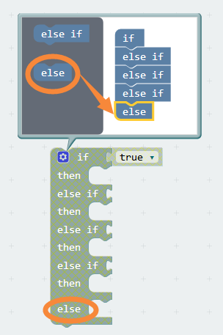
micro:bit programming tutorial
Part3
Attention! This time, unlike before, there is an "else" here. This means that when all the "else if" of the current face are not executed, the block in "else" is executed.
Yahboom micro:bit tutorial

Slide 11
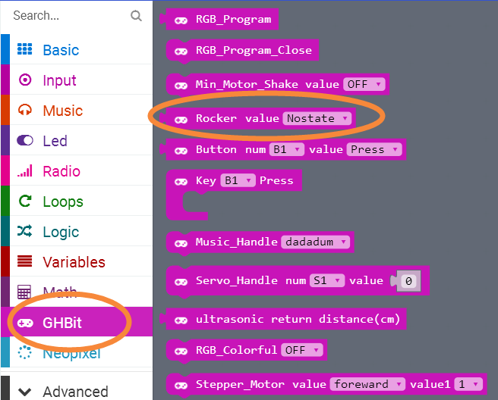
micro:bit programming tutorial
Part3
This is a rocker block, you can choose to return the value "Nostate, Up, Dwon, Left, Right, Press". This block can be used in conjunction with the last "if then" block.
Yahboom micro:bit tutorial

Slide 12
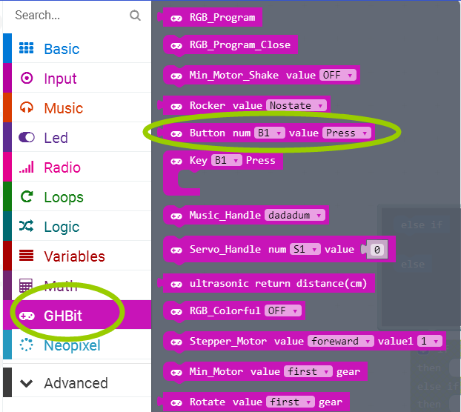
micro:bit programming tutorial
Part3
This is a building block about the keys. You can choose different keys to indicate that when this button is pressed, this building block can be combined with the "if then" building block.
Yahboom micro:bit tutorial

Slide 13
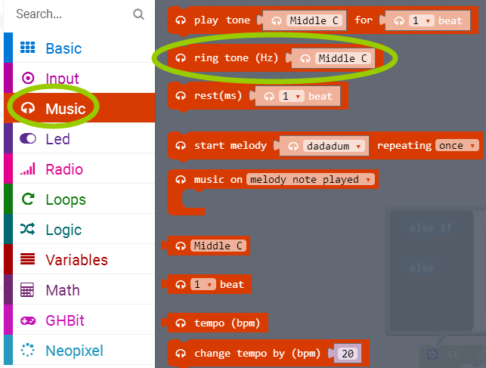
micro:bit programming tutorial
Part3
Plays tone through pin “P0”.In the handle, “P0” is connected to the buzzer, and the buzzer plays the ringtone.
Yahboom micro:bit tutorial

Slide 14
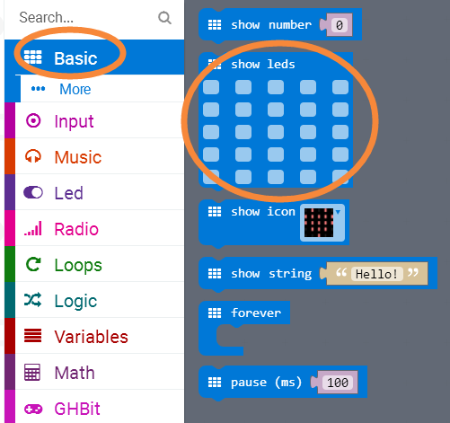
micro:bit programming tutorial
Part3
Draws an image on LED screen. Click on the small square above, the small square will turn red, and finally it will show up on the screen.
Yahboom micro:bit tutorial

Slide 15
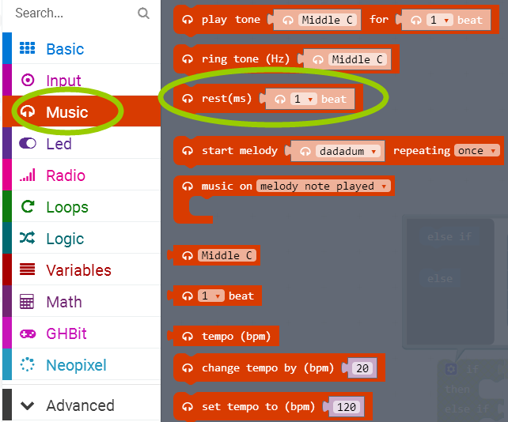
micro:bit programming tutorial
Part3
Rests(plays nothing)for a specified time through pin “P0”.
Yahboom micro:bit tutorial

Slide 16
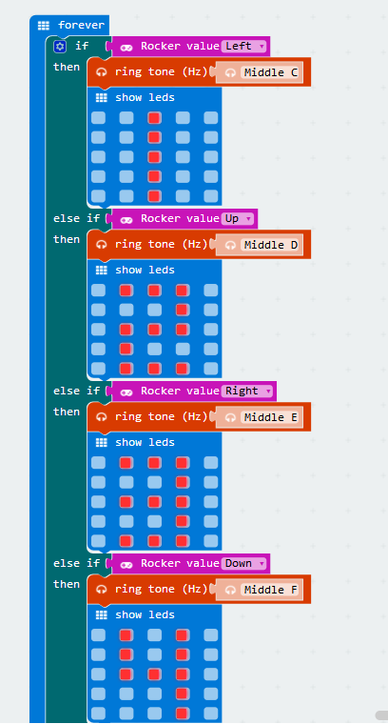
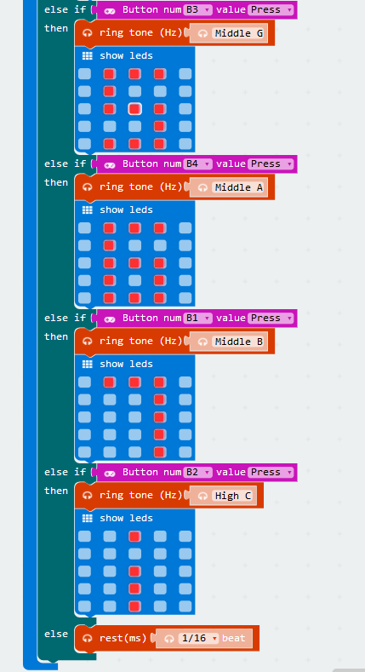
micro:bit programming tutorial
Part4
This is the complete building block for this course, let's download it to the micro:bit Game Handle.
Yahboom micro:bit tutorial

Slide 17
micro:bit programming tutorial
Part5
Do you learn the course today?
If you learn to do it, give yourself a top quack.
Now give you a homework assignment.
Choose a song you like, play it according to its notation and then program it out.
Start your little brain. Try it.
Yahboom micro:bit tutorial

Slide 18
micro:bit programming tutorial
micro:bit
Thanks for watching！
Yahboom
Yahboom micro:bit tutorial

